Slide 1
Introduction to C Programming II & Formatted Input/Output
Algorithm and programming

Slide 2
Learning Objectives
At the end of this session, student will be able to:
LO-1 : explain kind of algorithms in problem solving
LO-2 : apply syntax and functions in C language in problem solving

Slide 3
Subtopics
Variable
Data type
Casting
Constant
Sizeof
Suffix
Standard Function
Output Operation
Input Operation
Sample Program
Exercise

Slide 4
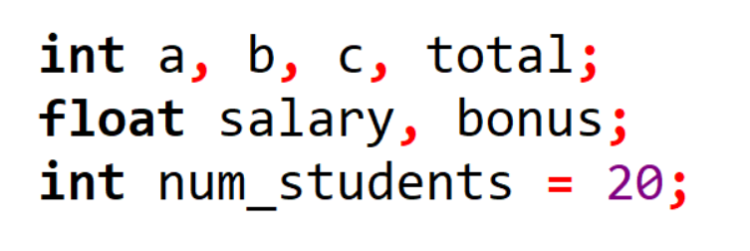
variable
definition
Identifier for storing data/information
Each variable has its name, address (L-value), type, size and data (R-value)
Data or variable value can be modified at run time
Declaration format:
<data type> <variable name>;
<data type> <variable name> = <initial value>;
Example:

Slide 5
variable
definition
Memory
char ch=65
address
65
ch
123456
name
Range of value: -128 – 127
value

Slide 6
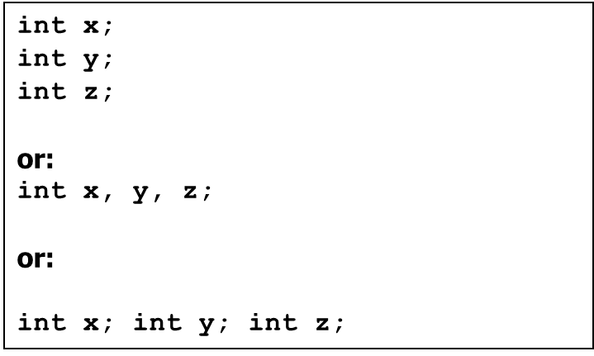
variable
Declaration
Variable can be declared at every statement block
Block statement or compound statement is statement exists between { and } sign
Example:

Slide 7
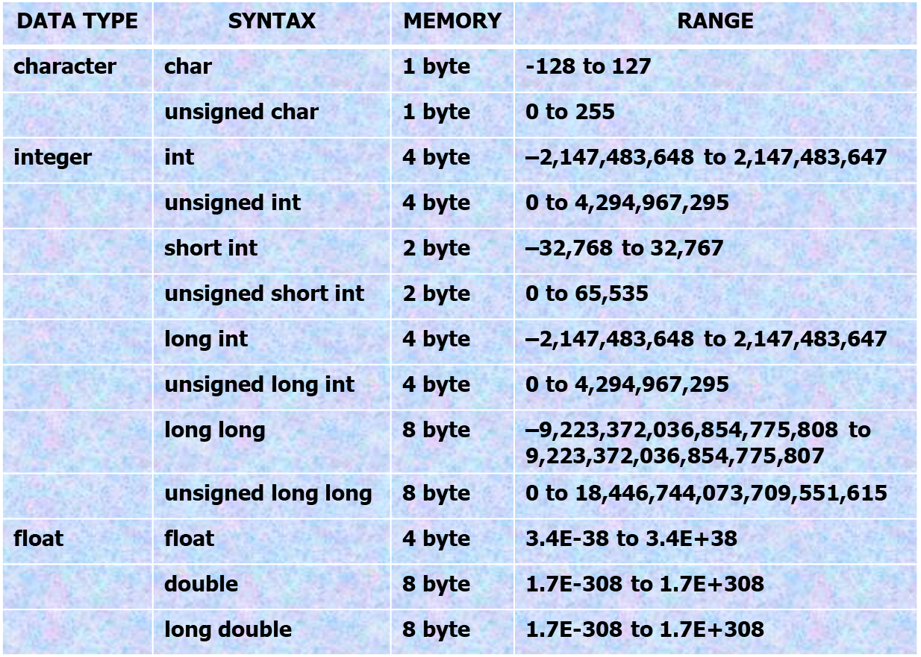
Data Type
Definition
In C, there are 5 data types and 4 modifiers
Data types:
  Character → char
  Integer → int
  Floating point → float
  Double floating point → double
  Void → void
Modifiers:
  signed
  unsigned
  long
  short
Void used in function identifier type as no return value. In variable, void data type is data type that can be transform into any data type (will be discussed later in pointer)

Slide 8
Data Type
Definition
Data type in C is a combination of basic data type and its modifier
Example:
  signed char
  unsigned int
  long int
  etc.

Slide 9
Data Type
definition
Casting is a process to convert data type in C
Syntax : (data type)
Example :
  int x;
  float f = 3.134;
  x = (int) f;
casting

Slide 10
constant
definition
Constant / symbolic constant does not have address (only value) and its value can not be changed at run time.
Constant type:
  Integer constant → -5 1
  Floating-point constant → 3.14
  Character constant → 'c' '1' '$'
  Escape sequence → \n \t \"
  String constant → "BINUS" "B"
  Symbolic constant → #define PHI 3.14
→ const float PHI=3.14;

Slide 11
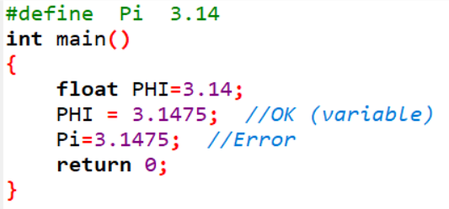
constant
Symbolic constant
Symbolic constant declaration does not need memory allocation
To declare symbolic constant, can be done by using pre-processor directive #define or keyword const
Example:
  const float Pi=3.14;
  #define Pi 3.14

Slide 12
SIZEOF
definition
sizeof is an operator to find out size of a data type in C language
Syntax:
  sizeof(expression)
Example :
sizeof(int) //the result will be 4 in Dev-V (Windows)
sizeof(int) //the result will be 2 in Turbo C ver 2.0 (DOS)

Slide 13
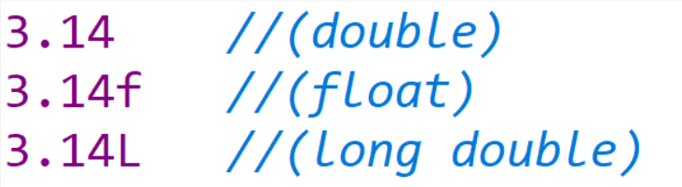
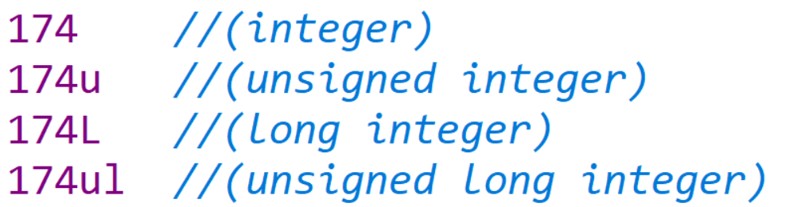
SUFFIX
definition
Suffix for floating point constant in C:
F or f for float data type
L or l for long double data type
Default double data type
Suffix for integer constant in C:
U or u for unsigned integer
L or l for long integer
UL or ul or LU or lu for unsigned long integer
Default integer
Example floating point constant:
Example integer constant:

Slide 14
SUFFIX
definition
Some compilers will give warning for differ in data type, as can be seen from the following example Visual C++:
Example :
float x;
x = 3.14;
warning: truncation from 'const double' to 'float’
How to deal with the issue? You may use casting or suffix
float x;
x = (float)3.14; // casting
x = 3.14f; // or suffix

Slide 15
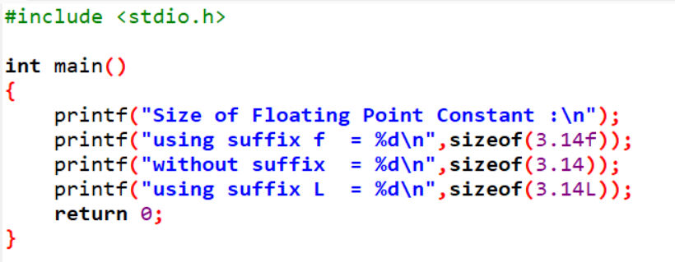
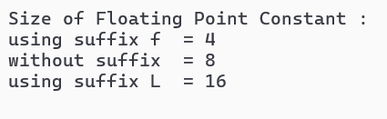
SUFFIX
example
Output

Slide 16
Standard function
Definition
Standard library function
  Predefined functions provided by the C compiler.
  To use them, include the appropriate header file using the #include directive.
  Example: For input and output operations, use the Standard Input/Output Library: #include <stdio.h>
User defined function
  Also called programmer-defined functions.
  Created by the programmer to perform specific tasks within a program.
  Help make code modular, reusable, and easier to manage.

Slide 17
OUTPUT OPERATION
FUNCTION USED
To display data on the screen, C provides several standard library functions, such as:
  printf()
  putchar()
  putch() (Note: available in conio.h)
  puts()
  etc.

Slide 18
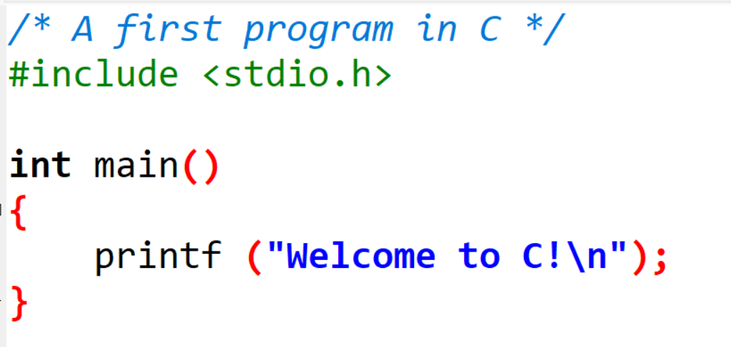
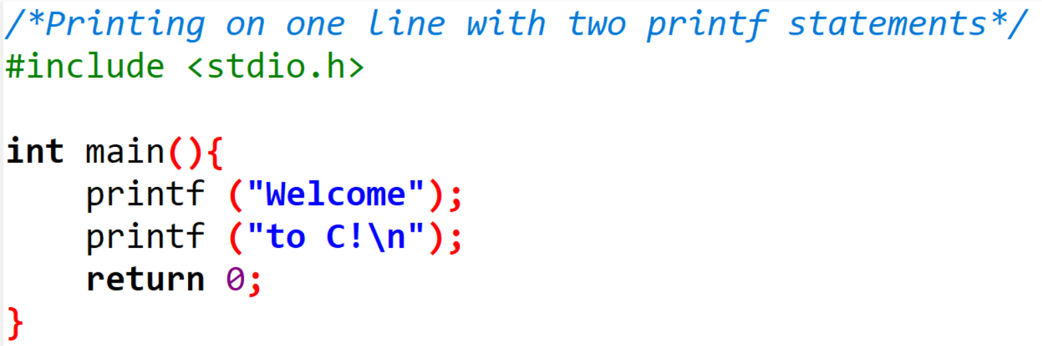
OUTPUT OPERATION
PRINTF FUNCTION
Used to display data on the standard output (typically the screen), with a specified format.
Header file : stdio.h
Syntax:
printf(const char *format[,argument, …]);
Example
Both programs will display the same output on the screen.

Slide 19
OUTPUT OPERATION
Output Formatting
Output also has formatted specification:
%[flags][width][.precision] type
width : number of columns provided
precision : digit number
flags :
can be changed into:
none : right justify
: left justify
+ : for positive & negative value
type :
d –or- i : signed decimal
o : unsigned octal
u : unsigned decimal
x : unsigned hexadecimal
f : floating point
e : floating point (exponent)
c : single character
s : string
% : % character
p : pointer

Slide 20
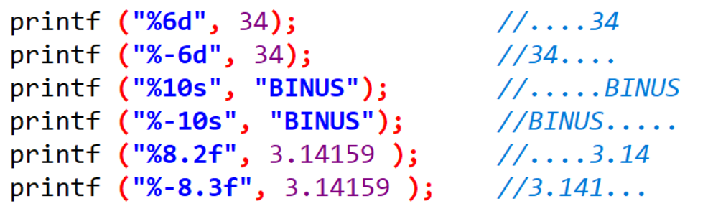
OUTPUT OPERATION
Output Formatting (CONT)
For long data type, add l at the front of data type:
long double → %lf
unsigned long int → %lu
long int → %ld
Example 1

Slide 21
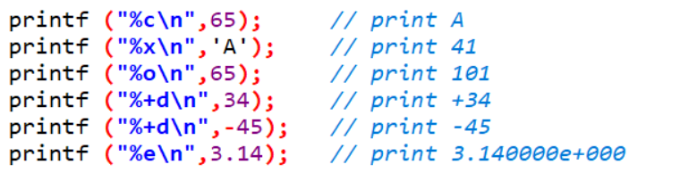
OUTPUT OPERATION
Output Formatting (CONT)
Example 2

Slide 22
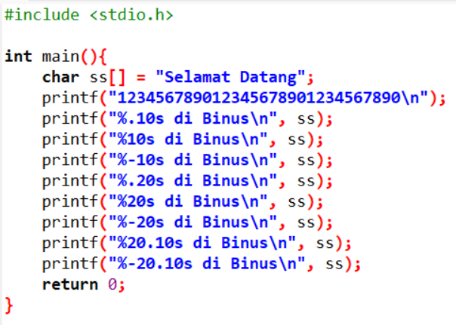
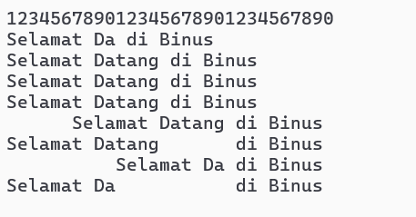
OUTPUT OPERATION
Output Formatting (CONT)
Example 3
Output

Slide 23
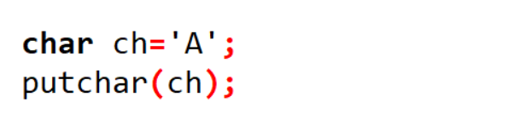
OUTPUT OPERATION
PUTCHAR FUNCTION
Functionality:
  Displaying character on the monitor at cursor position. After display, cursor will move to the next position
  Return EOF if error, and return the displayed character after successfully done
  putchar is a macro similar to : putc(c, stdout )
Header File: stdio.h
Syntax:
int putchar(int c);
Example:
Output:
A

Slide 24
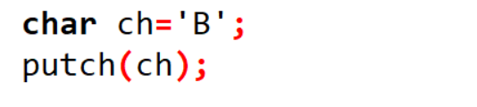
OUTPUT OPERATION
putch function
Functionality:
  Display ASCII character to the monitor without moving cursor to its next position
  Return EOF if error, and return the displayed character after successfully done
Header File: conio.h
Syntax:
int putch(int c);
Example:
Output:
B

Slide 25
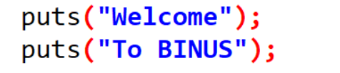
OUTPUT OPERATION
PUTS FUNCTION
Functionality:
  Display string to the monitor and move the cursor to new line
  Return non-negative value when successful and EOF if error)
Header File: stdio.h
Syntax:
int puts(const char *str);
Example:
Output:
Welcome
To BINUS

Slide 26
INPUT OPERATION
FUNCTION USED
Input Operation:
The process of receiving data into memory using standard input devices (such as a keyboard or disk).
Standard library functions related to input operations include:
scanf()
getchar()
getch() (Note: available in conio.h)
getche() (Note: available in conio.h)
gets()
etc.

Slide 27
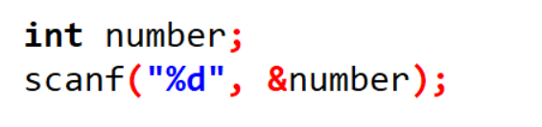
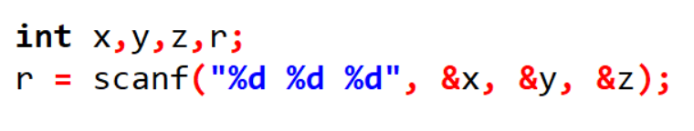
INPUT OPERATION
scanf function
All the argument type are pointers (address of a variable).
To get the address of a variable use “&” sign.
Header file : stdio.h
Syntax:
  int scanf( const char *format [,argument]... );
  *format: “%type”, where type can be substituted with one of the following list (next page)
scanf() function returns an integer that stated how many fields are successfully assigned
Example:
  *Input three values of integer, for example 6 7 8, then r = 3;

Slide 28
INPUT OPERATION
scanf function (CONT)
Format Type
Type | Used to scan
d u x e, f, g c | integer unsigned integer hexadecimal floating point single character
s o […] [^..] | string ended with white space data unsigned octal string ended with non of the value inside [...] string ended with the value inside [...]

Slide 29
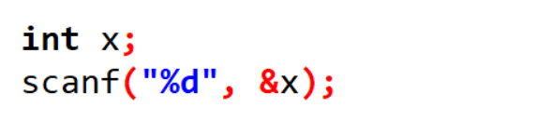
INPUT OPERATION
scanf function (CONT)
If exist an x integer variable, state the difference of x and &x?
Variable Name X | Address 45678 | Value 234
  Answer:
  x : 234
  &x : 45678

Slide 30
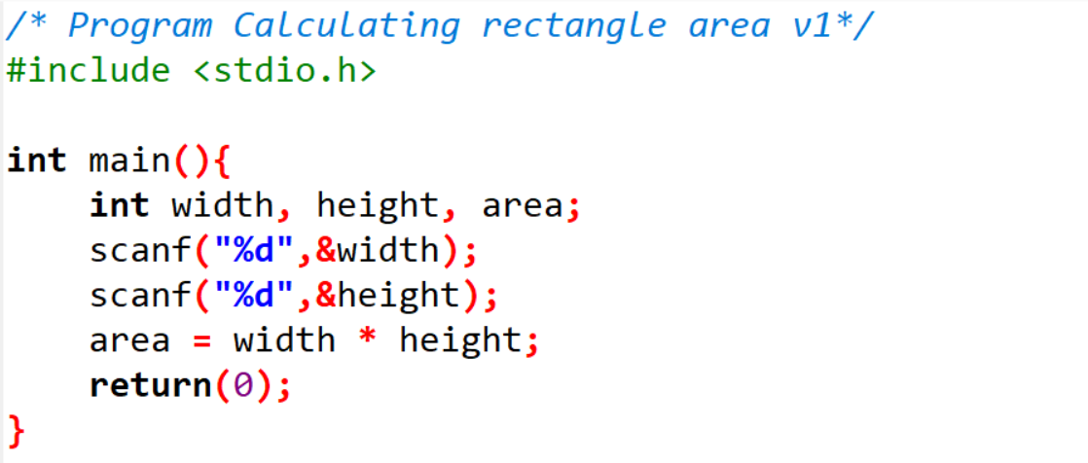
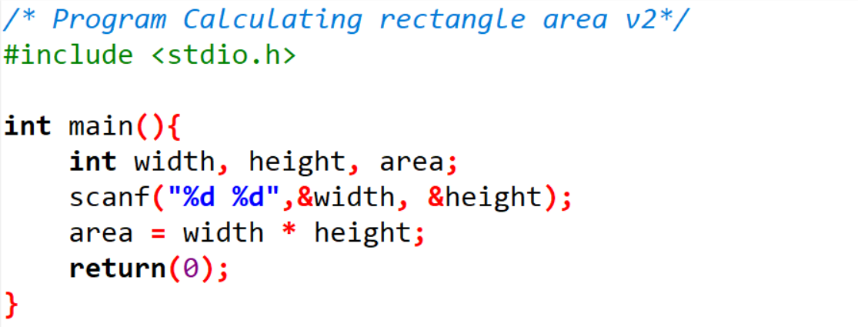
INPUT OPERATION
scanf function EXAMPLE PROGRAM
scanf() function can use more than one argument

Slide 31
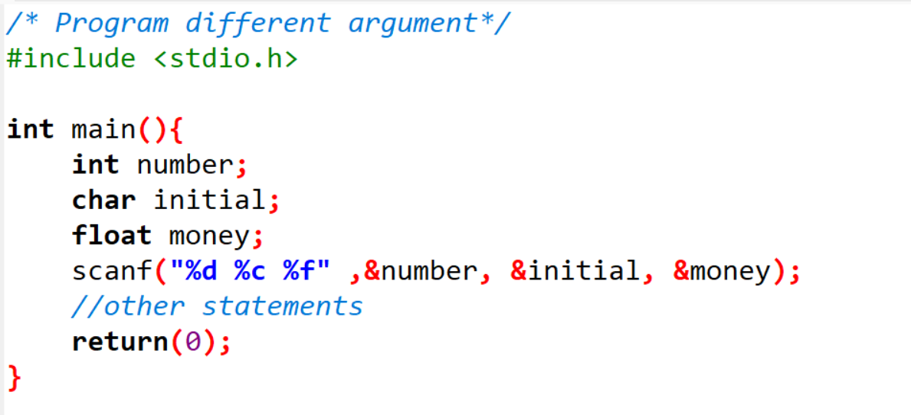
INPUT OPERATION
scanf function EXAMPLE PROGRAM
Data type for each variable in the function argument can be different

Slide 32
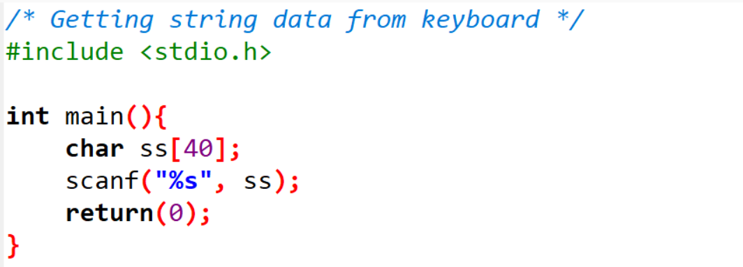
INPUT OPERATION
scanf function EXAMPLE PROGRAM
ss variable is a pointer then we need not putting extra & sign (&ss) in the function argument (pointer will be discussed later separately)
String takes only till the first whitespace found

Slide 33
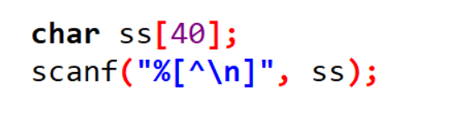
INPUT OPERATION
INPUT FORMATTING
Space char, tab, linefeed, carriage-return, form-feed, vertical-tab, and new-line entitle ”white-space characters”
Using previous example, if a string “good morning every one” entered then ss value will only contain “good”
To get string that ended with certain character for example Enter (new line), use scanf() with format: [^\n]
Example 1:
%[...] tells scanf to read a sequence of characters that match a certain set.
^ (caret) means "not“. [^\n] means read all characters until a newline character is encountered.
This allows the user to input a full line of text (including spaces), and scanf will stop reading when it encounters a newline (Enter key).

Slide 34

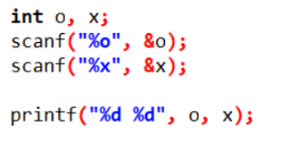
INPUT OPERATION
INPUT FORMATTING (CONT)
Example 2:
If the string is: http://binusmaya.binus.ac.id, ss variable will contain only http.
This happens because the character : is not a letter (a–z), so it is treated as the end of the string segment being processed.
Example 3:
If the input value is 44:
If interpreted as an octal number, it is equal to 36 in decimal.
If interpreted as a hexadecimal number, it is equal to 68 in decimal.

Slide 35
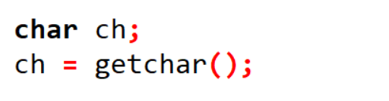
INPUT OPERATION
GETCHAR FUNCTION
Functionality:
  Return the next ASCII character from keyboard buffer
  Shown on the monitor screen
  Awaiting for ENTER pressed
Header File: stdio.h
Syntax:
int getchar(void);
Example:

Slide 36
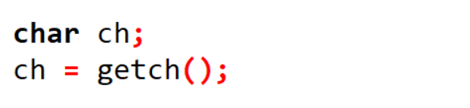
INPUT OPERATION
getch FUNCTION
Functionality:
  Return the next ASCII character from keyboard buffer
  Does not show on the monitor screen
  Does not wait for ENTER pressed
Header File: conio.h
Syntax:
int getch(void);
Example:

Slide 37
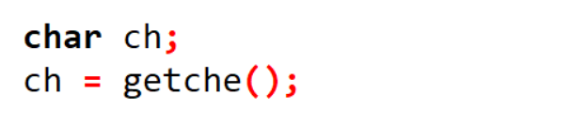
INPUT OPERATION
getchE FUNCTION
Functionality:
  Return the next ASCII character from keyboard buffer
  Shown on the monitor screen
  Does not wait for ENTER pressed
Header File: conio.h
Syntax:
int getche(void);
Example:

Slide 38
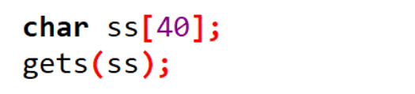
INPUT OPERATION
GETS FUNCTION
Functionality:
  Read a string from keyboard till find new-line and save in buffer
  New-line will later on replaced with null character
  Will return NULL if error and return its argument (buffer) if success
Header File: stdio.h
Syntax:
char *gets(char *buffer);
Example:

Slide 39
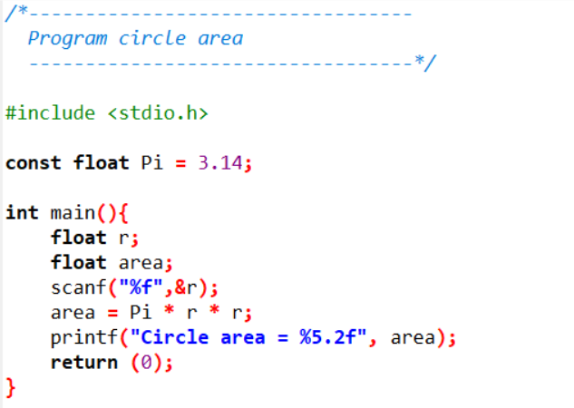
Sample program

Slide 40
exercise
Question 1
int x,y,z,w;
x=scanf("%d %d %d",&y,&z,&w);
What happen if input was 2 integer values from the keyboard?
What is x value if 3 characters values given as the input?
Question 2
char ss1[40];
char ss2[40];
x=scanf(”%s %s”,ss1,ss2);
What is ss1 and ss2, if the input from keyboard is ”Good morning everyone” ?
What is x if the input : ”Class 1PAT” ?

Slide 41
exercise
Question 3:
char ss[40];
scanf(”%4s”, ss);
What is ss value, if the input : ”Good morning” ?
Question 4:
char ch;
ch = getchar();
What is ch value, if the input : Binus ?
Question 5:
char ch1, ch2;
ch1 = getchar(); // input word “Binus” here!
ch2 = getchar();
What is the value of ch1 and ch2, if the input : Binus ?

Slide 42
exercise
Question 6:
Create a program in C to receive input from standard input (keyboard) for the following data:
Assignment Score
Mid Exam Score
Final Exam Score
Calculate and display Final Score using :
Final Score = 20%*Assignment + 30%*Mid + 50%*Final

Slide 43
exercise
Question 7:
#include <stdio.h>
int main()
{
char name[40];
int nim;
char gender;
printf("Name:"); scanf("%[^\n]",name);
printf("StudentNum :"); scanf("%d",&nim);
printf("Gender (M/F):"); gender=getchar();
return 0;
}
After entering name and student number, program will exit to prompt. gender=getchar() seems to be never executed. Explain why?

Slide 44
exercise
Question 8:
#include <stdio.h>
int main(){
char ss[]="10 % 3 = 1\n";
char str[]=“Welcome to Binus everyone\n";
printf(ss);
printf("%s",ss);
printf(str);
printf("%s",str);
return 0;
}
What is the output of the above code ?

Slide 45
SUMMARY
Syntax for Output:
printf, putchar, putch, puts
Syntax for Input:
scanf, getchar, getch, getche, gets
The screen (DOS mode) divided into row and column, normally max column = 80 and max row = 25

Slide 46
REFRENCES
Paul Deitel & Harvey Deitel. (2021). C how to program. 09. Pearson Education. New York. ISBN: 9780137398393.
Reading from and Writing to Standard I/O: http://aelinik.free.fr/c/ch05.htm
C Input/Output (I/O): https://www.programiz.com/c-programming/c-input-output

